Slide 1


Microsoft Certified: Data Analyst Associate
1. Introduction

Slide 2
Introduction
Overview for PL – 300 exam
Setting up Power BI desktop and Power BI service
Measured skills review
Prepare the Data (15-20 %)
Model the data (30-35%)

Slide 3
Introduction continued…
Measured skills review
Visualise and Analyse the data (25-30%)
Deploy and Maintain Assets (20-25%)

Slide 4
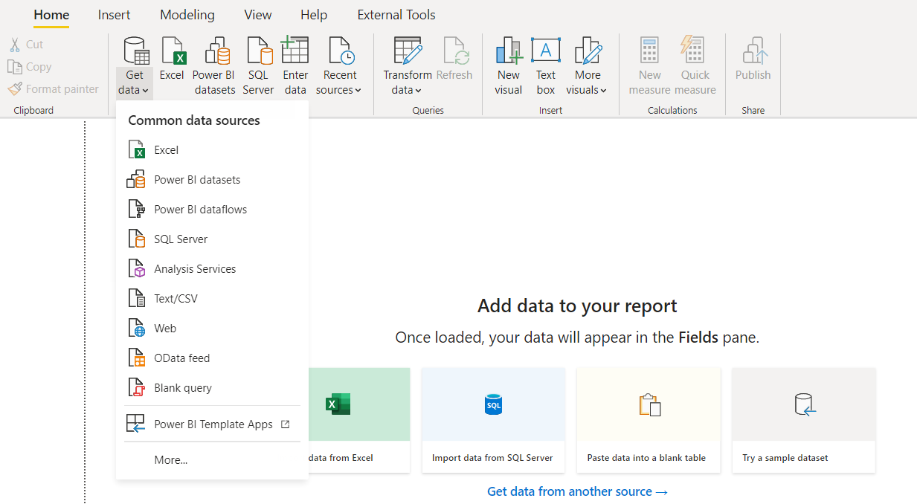
Prepare the data –get data from different data sources
Identify and connect to a data source

Slide 5
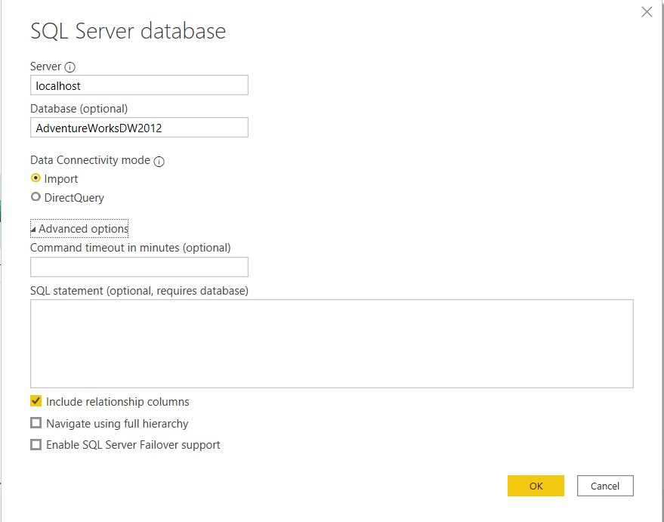
Prepare the data –get data from different data sources
Change data source settings

Slide 6
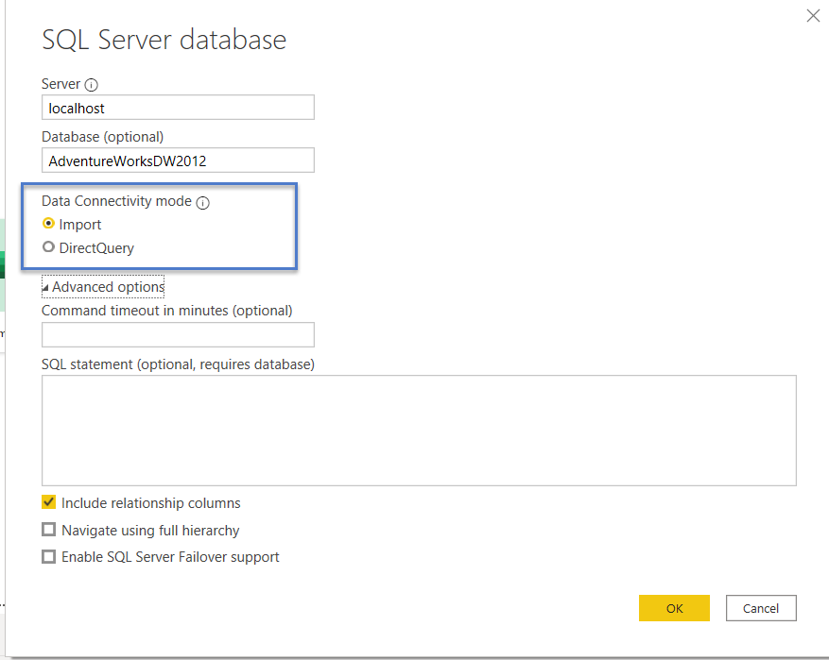
Prepare the data –get data from different data sources
Select a storage mode

Slide 7
Prepare the data –get data from different data sources
Select a shared dataset or create a local dataset
Use Microsoft Dataverse
Change the value in a parameter
Connect to a dataflow

Slide 8
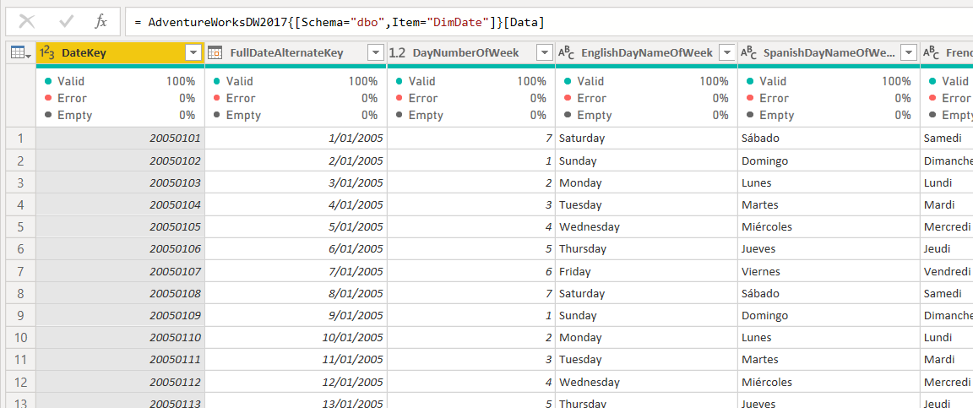
Prepare the data –clean transform and load the data
Profile the data

Slide 9
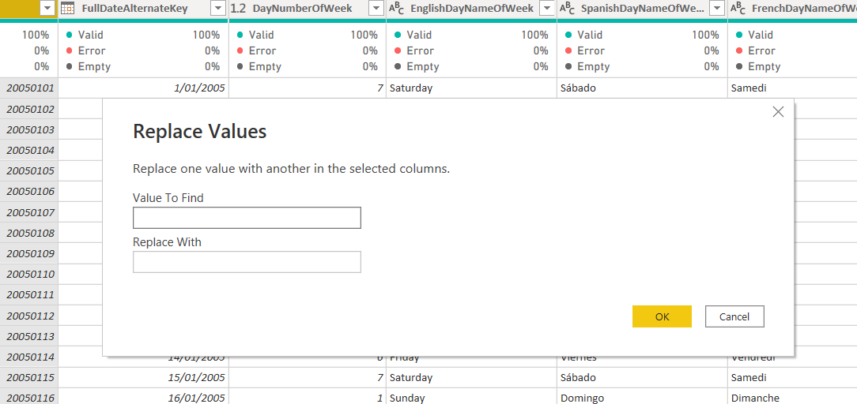
Prepare the data –clean transform and load the data
Resolve the inconsistencies, unexpected or null values, and data quality issues

Slide 10
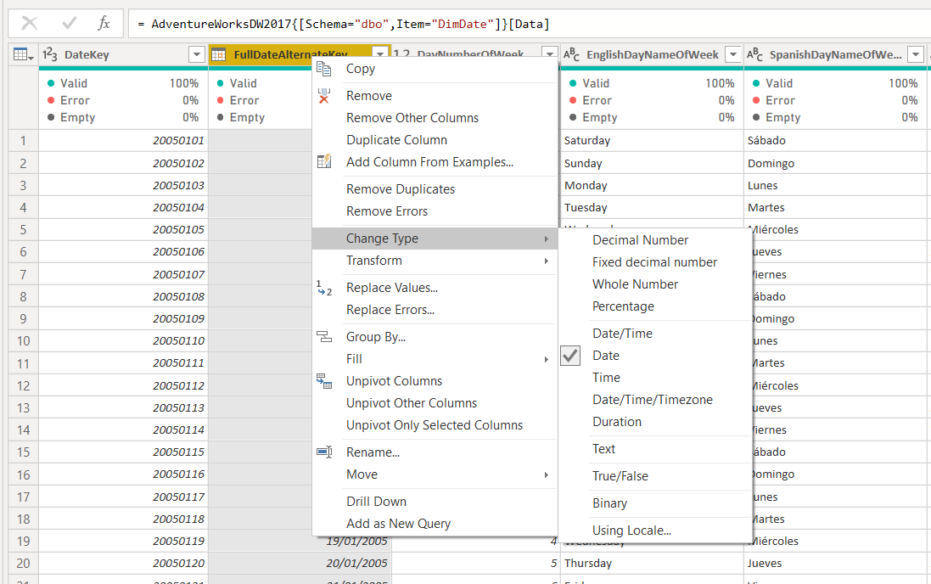
Prepare the data –clean transform and load the data
Evaluate and transform column data types

Slide 11
Prepare the data –clean transform and load the data
Identify and create appropriate keys for joins
Shape and transform tables
Combine queries
Apply user friendly naming conventions to columns and queries
Configure data loading
Resolve data import errors

Slide 12
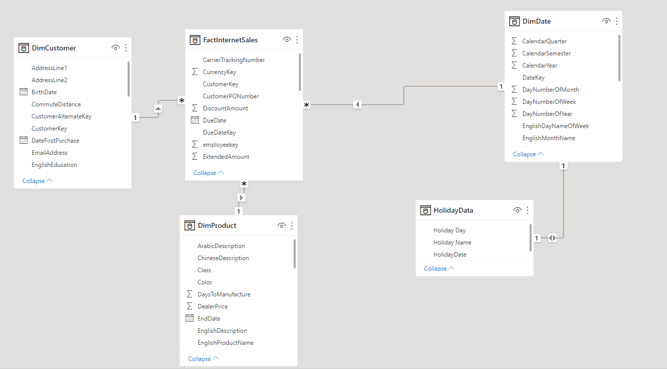
Model the data- Design a data model
Design a data model

Slide 13
Model the data- Design a data model
Configure table and column properties
Design and implement role playing dimensions
Design a data model that uses a star schema
Create a common date table

Slide 14
Model the data- Design a data model
Create calculated tables
Create hierarchies
Create calculated columns
Implement row-level security roles
Use the Q & A feature

Slide 15
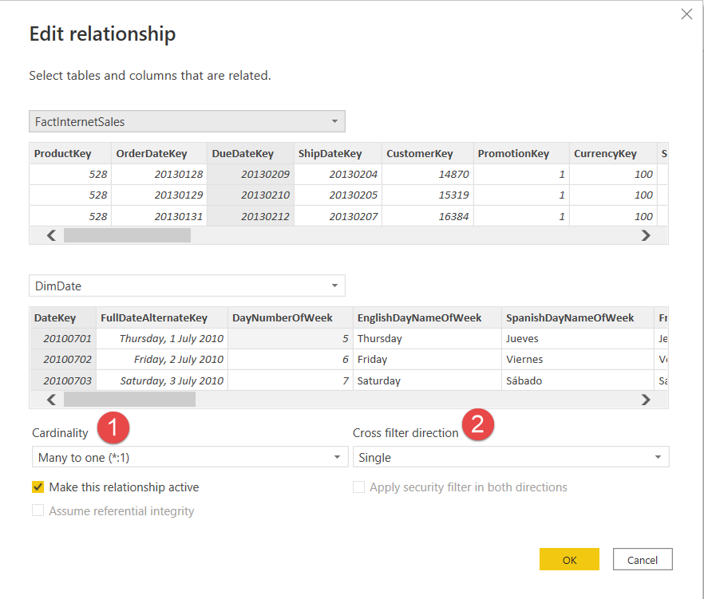
Model the data- Develop a data model
Define a relationships cardinality and cross filter direction

Slide 16
Model the data- Develop a data model
Create calculated tables
Create hierarchies
Create calculated columns
Implement row-level security roles
Use the Q & A feature

Slide 17
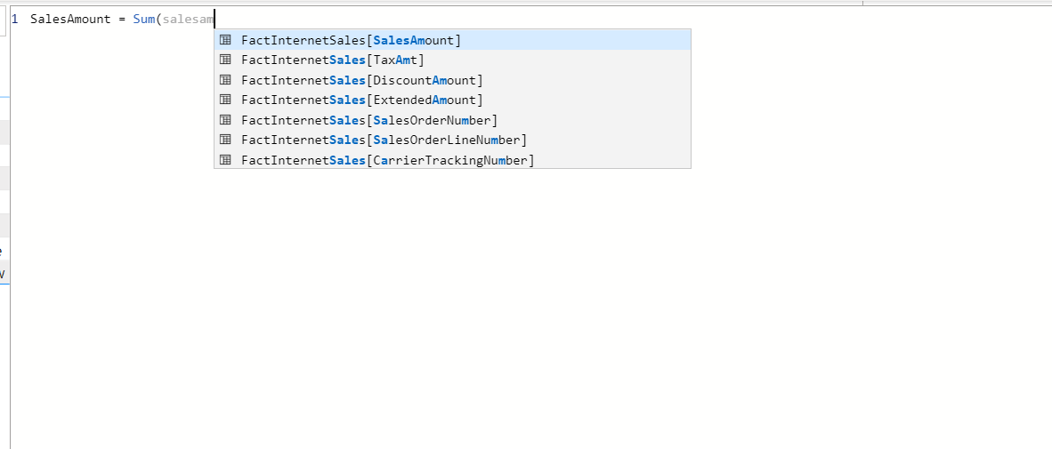
Model the data- Create model calculations using DAX
Create basic measures by using DAX

Slide 18
Model the data- Create model calculations using DAX
Use calculate to manipulate filters
Implement time intelligence using DAX
Replace implicit measures with explicit measures
Use basic statistical functions
Create semi additive measures

Slide 19
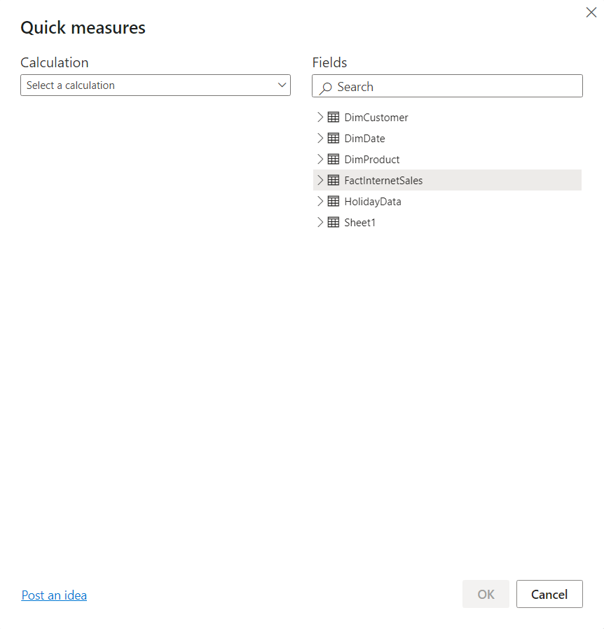
Model the data- Create model calculations using DAX
Use quick measures

Slide 20
Model the data- Create model calculations using DAX
Use quick measures

Slide 21
Model the data- Optimise model performance
Remove unnecessary rows and columns
Identify poorly performing measures, relationships and visuals
Reduce cardinality levels to improve performance

Slide 22
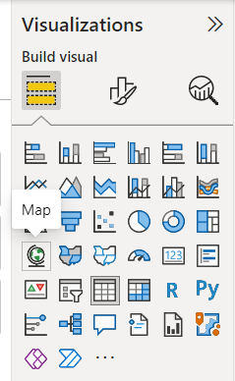
Visualise and analyse data – create reports
Add visualization items to reports
Choose and appropriate visualisation type

Slide 23
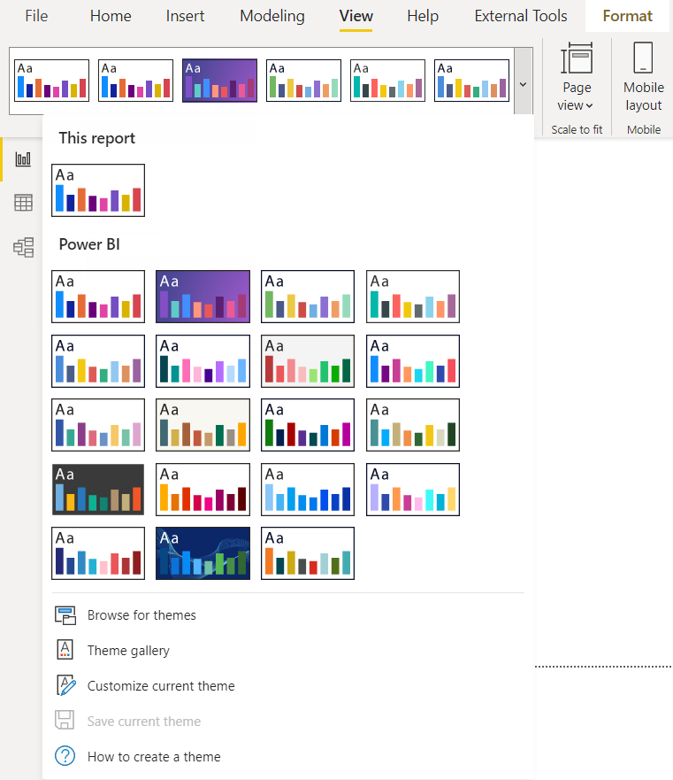
Visualise and analyse data – create reports
Format and configure visualisations
Use a custom visual
Apply and customise a theme

Slide 24
Visualise and analyse data – create reports
Configure conditional formatting
Apply slicing and filtering
Configure the report page
Use the analyse in excel feature
Choose when to use a paginated report

Slide 25
Visualise and analyse data – create dashboards
Manage tiles on a dashboard
Configure mobile view
Use the Q&A feature
Add a quick insights result to a dashboard
Apply a dashboard theme
Pin a live page to a dashboard

Slide 26
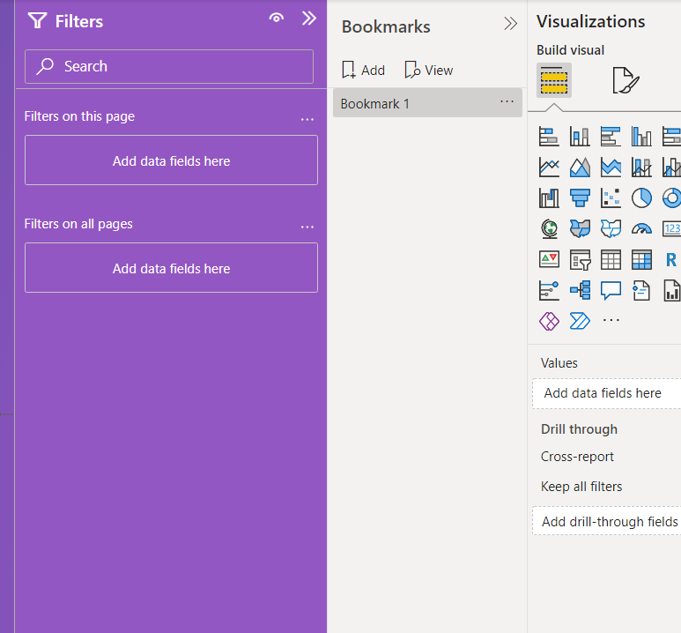
Visualise and analyse data – enhance reports for usability and story telling
Configure bookmarks

Slide 27
Visualise and analyse data – enhance reports for usability and story telling
Create custom tool tips
Edit and configure interactions between visuals
Configure navigation for a report
Apply sorting
Configure sync slicers

Slide 28
Visualise and analyse data – enhance reports for usability and story telling
Group and layer visuals by using the selection pane
Drilldown into data using interactive visuals
Export report data
Design reports for mobile devices

Slide 29
Visualise and analyse data – identify patterns and trends
Use the analyse feature in Power BI
Identify outliers
Choose between continuous and categorical axes
Use groupings, binning's, and clustering
Use AI visuals
Use the forecast feature
Create reference lines by using the Analytics pane

Slide 30
Deploy and maintain Assets – Manage files and datasets
Identify when a gateway is required
Configure a dataset schedule refresh
Configure row-level security group membership
Provide access to datasets
Manage global options for files

Slide 31
Deploy and maintain Assets – Manage workspaces
Create and configure a workspace
Assign workspace roles
Configure and update a workspace app
Publish, import, or update assets in a workspace
Apply sensitivity labels in workspace content
Configure subscriptions and data alerts
Promote or certify Power BI content

Slide 33
Microsoft Certified: Data Analyst Associate
Case Study

Slide 34

Case study
Situation
You have been hired as the principal data analysts for PBI CycleWorks. PBI CycleWorks is a boutique bicycle equipment shop
Build and end-to-end business intelligence solution. Use raw data about sales information, product, product category, Employee and customer information.
Build and distribute Power BI reports using the Microsoft Power BI Ecosystem
Case
Tools
Extract, Transform and Load the data using Power Query Editor
Model the data in Power BI Desktop
Visualise the data
Analyse the data
Distribute the reports and dashboards using Power BI Service

Slide 35
Microsoft Certified: Data Analyst Associate
Data Model

Slide 36
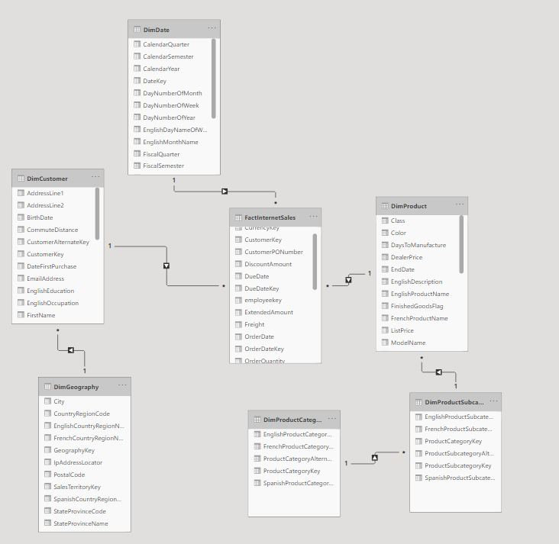
Data Model
Table Name | Table Description
DimCustomer | Information about customers who purchase cycles and cycle accessories with PBI CycleWorks
DimDate | Date related information like day, week, month, quarter and year for a given date
DimGeography | Geographical information about the customers who buy our products
DimProduct | Contains information about the products available for sale
DimProductCategory | Contains information about the product categories
DimProductSubCategory | Contains information about product subcategories
FactInternetSales | This tables contains information about the sales transactions for PBI cycleworks
Additional Sources:
MS SSAS Tabular
MS Dataverse

